Slide 1

Welcome

Slide 2
Presented by:
name | id
Md. Abir Hassan | 011 171 146

Slide 3
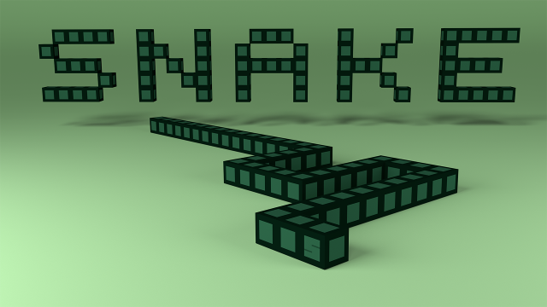
Project : game

Slide 4
Introduction :
The game called "Snake" or "Snake Game"
The Snake has appeared in many different forms over the decades, but it’s first appearance took place in the mid 1970s and was called Blockade. It was the creation of Gremlin Industries, who specialized in coin-operated arcade machines. In 1984, they closed their doors, never to open again. But their game still lives on.
By 1997, it had found its way into people’s pockets, onto their Nokia phones and created the craze of mobile gaming among teenagers. The Nokia 6110 was Nokia’s first phone with Snake and they continued to manufacture new models with the game installed throughout the next decade.

Slide 5
features :
play
start
Game menu
instruction
exit
end

Slide 6
features :
The most common version of the game involves the snake eating items which make it longer.
The player loses when the snake either runs into its own body.
The number keys “ d , a , w , s ” has been set within the program to move the snake to right, left, top and bottom respectively
Update difficulty according with score
High score

Slide 7
methods :
void movement();
void Eat_and_dead();
void key_input();
void Draw_board();
int high_score(int read);
void update_difficulty();
void welcome_show();
void instructions();
void thank_show();
void game();

Slide 8
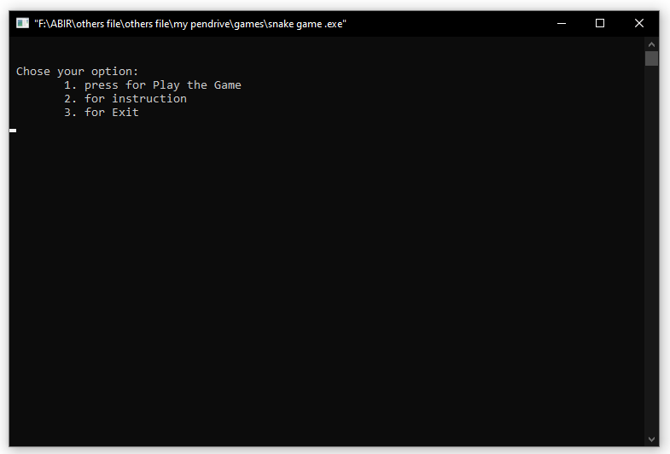
Screenshot :

Slide 9
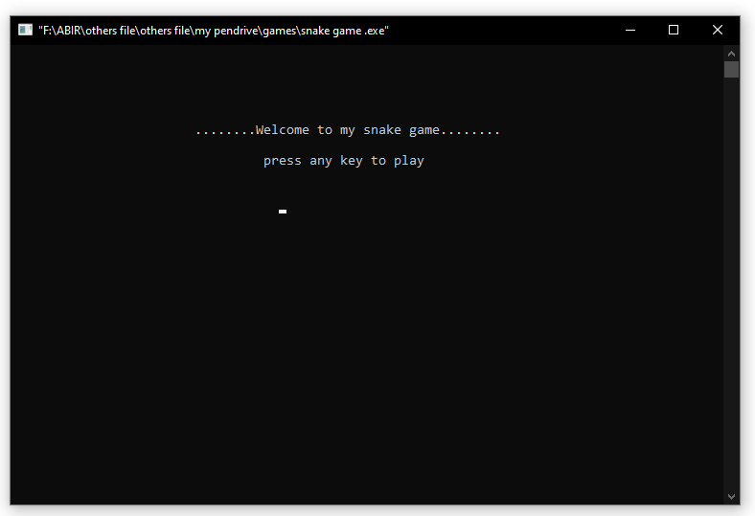

Slide 10
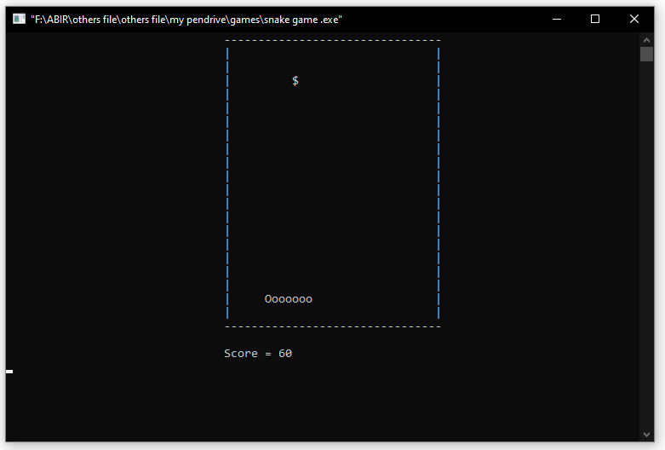

Slide 11
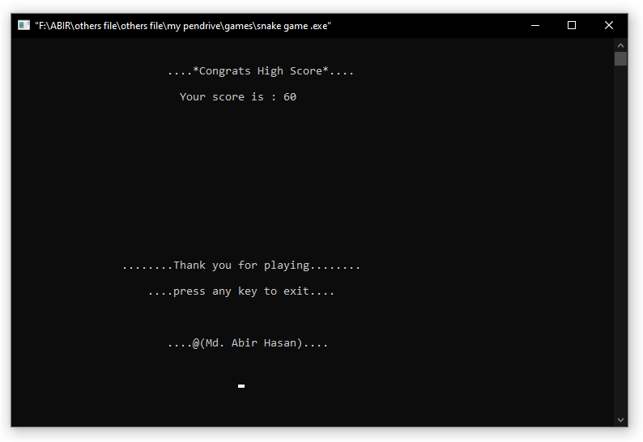
After you die

Slide 12
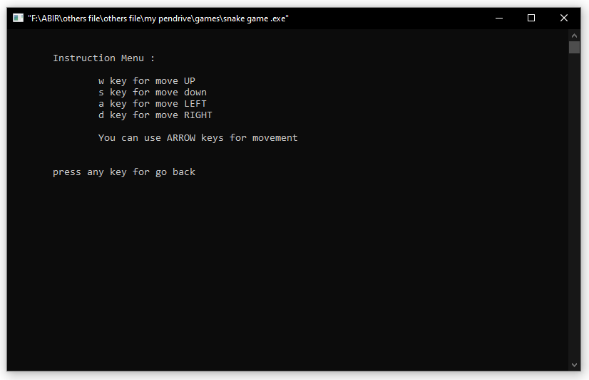
instruction

Slide 13
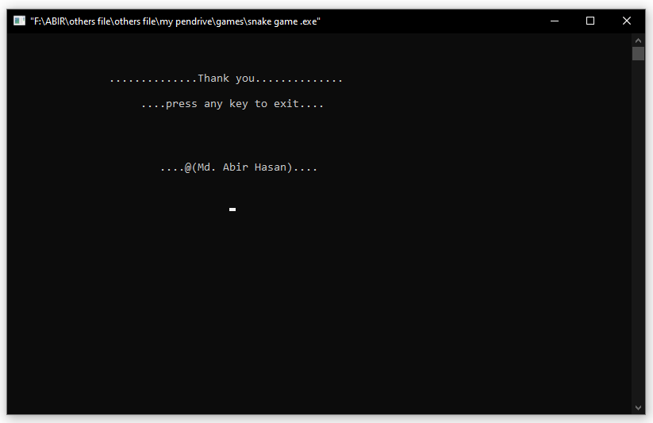
exit

Slide 14


